Slide 1

Status Report Network Performance Evaluation on Linux-Based Operating Systems (Physical Team)
Client: Dr. Raymond Lutui | Mentor: Daniel Vaipulu

Slide 2
Project Brief
Network Performance Evaluation on Linux OS
Ubuntu, Fedora, Kali
IPv4 and IPv6
TCP and UDP protocols

Slide 3
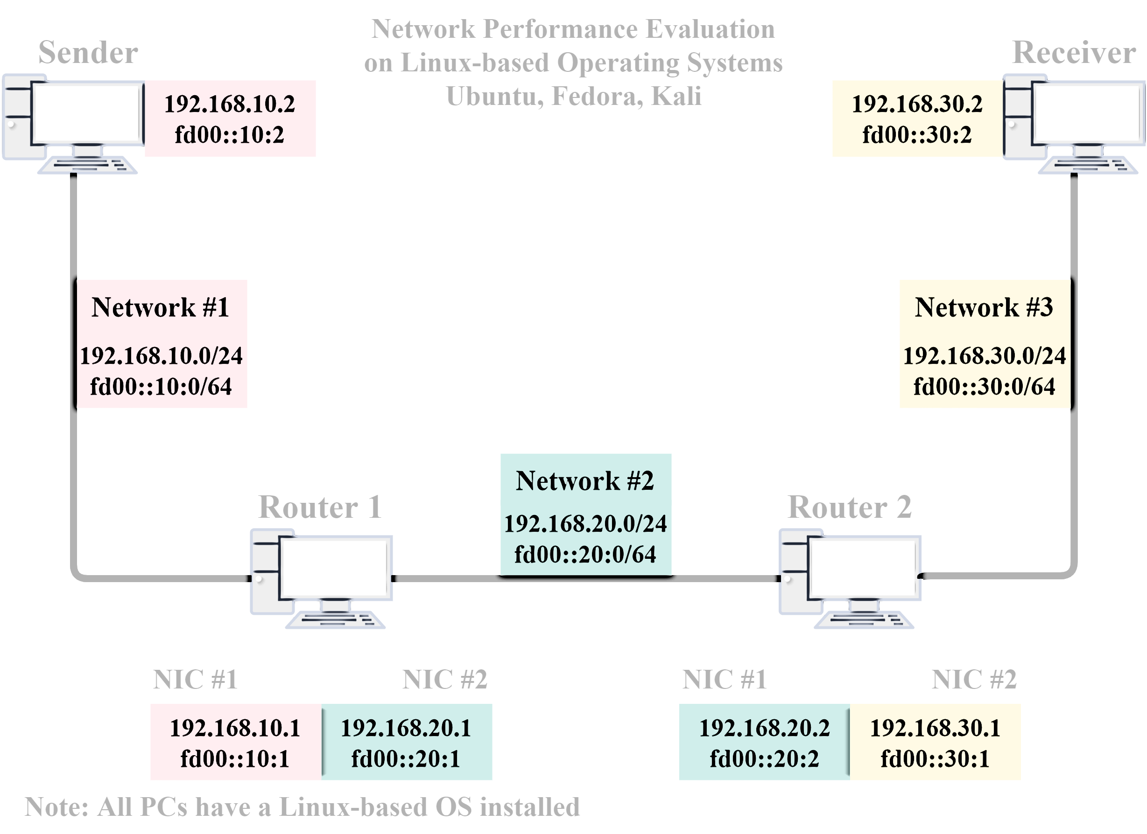
Technical Infrastructure

Slide 4
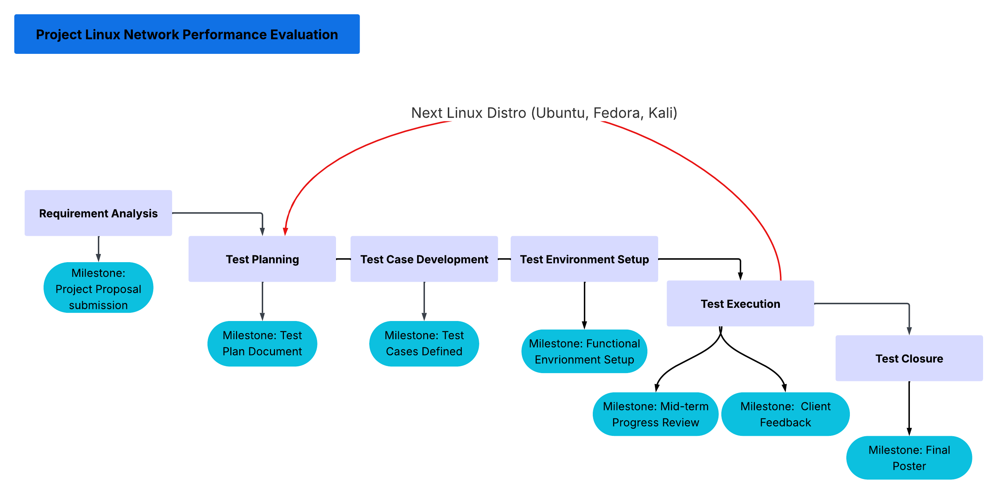
Work Breakdown Structure (High-Level)

Slide 5
Project Status
Phases | Planned Completion | Actual Status
Requirement Analysis | 11/04/2025 | 11/04/2025 Completed
Test Planning - Ubuntu | 02/05/2025 | 26/04/2025 Completed
Test Case Development - Ubuntu | 06/06/2025 | 26/04/2025 Completed
Test Environment Setup - Ubuntu | 04/07/2025 | 03/05/2025 Completed
Test Execution - Ubuntu | 31/07/2025 | Current Phase Scheduled to finish on 22/06/2025
Test Planning - Fedora | Next Phase (Scheduled to start on 23/06/2025)

Slide 6
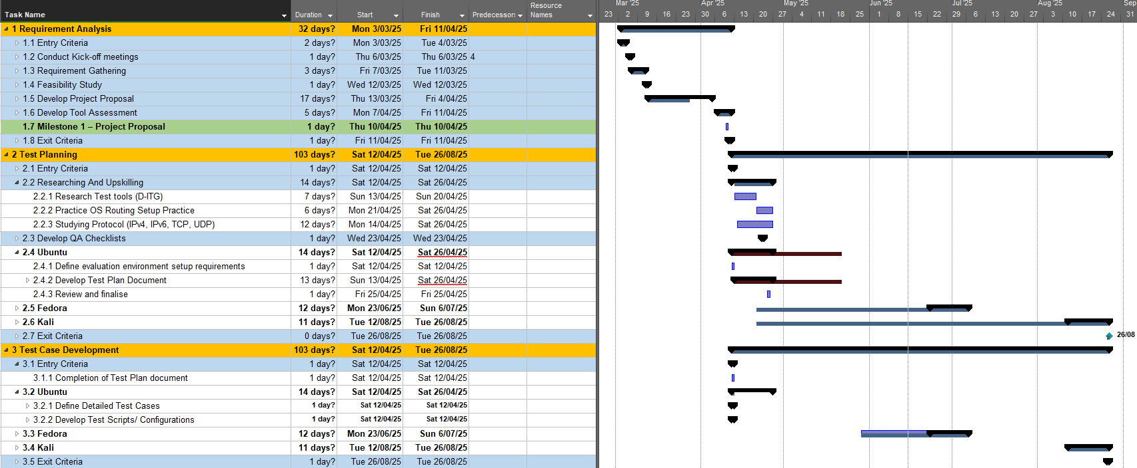

Slide 7
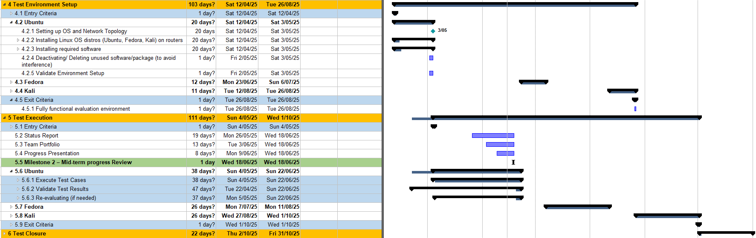

Slide 8
Summary
Currently, our project is ahead of our original schedule, so we have pulled forward our phase start and completion dates in response. The project is now nearing the end of the Test Execution phase for our first operating system, Ubuntu. Barring any unforeseen circumstances, we plan to start the next phase, Test Planning of our second operating system, Fedora, in approximately a week.
Notes:
Currently, our project is ahead of our original schedule, so we have pulled forward our phase start and completion dates in response. The project is now nearing the end of the Test Execution phase for our first operating system, Ubuntu. Barring any unforeseen circumstances, we plan to start the next phase, Test Planning of our second operating system, Fedora, in approximately a week.

